Slide 1
Lecture 7
CS494 – Information System Audit and Control
25th March 2023

Slide 2
Recap of IT Management.
IT resource management.
IT service provider acquisition and management.
IT performance monitoring and reporting.
Quality assurance and quality management in IT.

Slide 3
IT performance monitoring and reporting
If you cannot measure something, you cannot manage / improve it.
Provides management with a level of comfort that IT operations are moving in the desired direction.
It is extremely important to develop performance metrics for monitoring performance.
E.g System uptime, network uptime, ticket resolution time

Slide 4
IT performance monitoring and reporting
Enterprises that want to effectively monitor IT activities to ensure they are aligned with the overall business goals often use KPIs.
KPI = Key Performance Indicator
A quantifiable measure of performance over time for a specific objective
What would be an IT KPI for Foodpanda or Daraz?
System Uptime: This KPI measures the percentage of time that a system or application is available and functioning properly.

Slide 5
Sample KPIs
KPI = 99.9% application uptime annually.
Customer Satisfaction score of IT services at 4.25 / 5.
Can you think of any KPI ?

Slide 6
Developing performance metrics
Step 1: Identify the critical process: The first step is to identify the critical process that needs to be monitored.
Step 2: Identify the expected output: The second step is to define the expected output or target for each process that needs to be monitored.
Step 3: Compare the actual output with the target: On a periodic basis, compare the actual output with the target.
If the target is not achieved, conduct a root cause analysis to determine areas of improvement.

Slide 7
Performance measurement& improvement methodologies
Six Sigma – methodology to remove defects in processes.
Lean Six Sigma – remove unnecessary steps that don’t add value. E.g. starbucks
IT Balanced Scorecard – Helps keep IT and Business goals aligned.

Slide 8
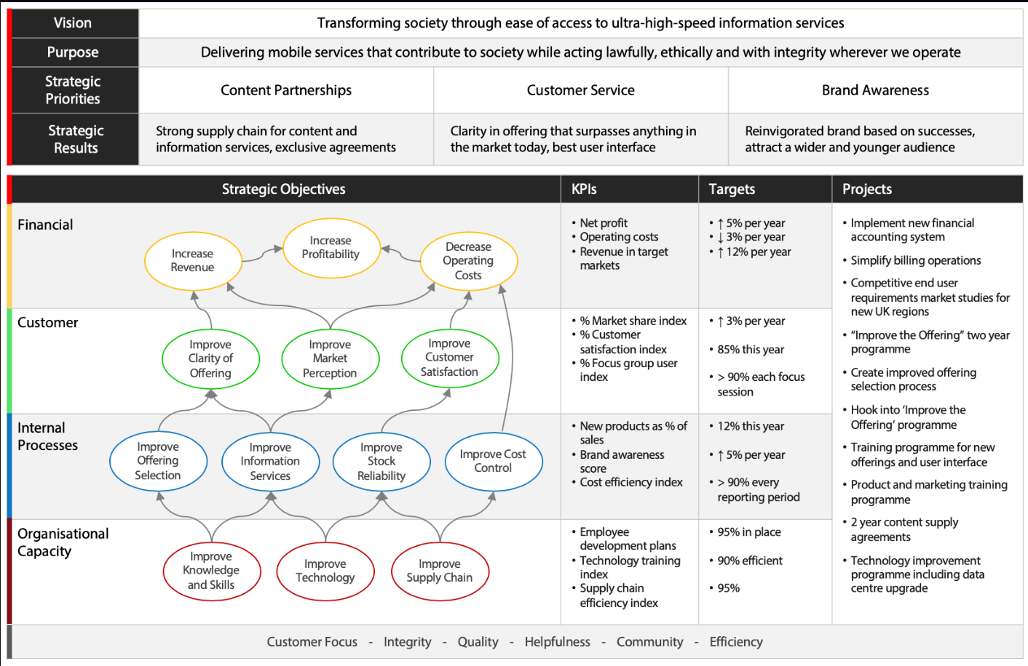

Slide 9
Quality assurance and quality management in IT
Define Quality?
Quality refers to the degree to which a product, service, or process meets or exceeds customer expectations and requirements.
Organizations setup QA functions to manage quality.
To enable the QA function to play an effective role, the QA group should be independent within the organization.

Slide 10
Quality Assurance vs Quality Control
Quality assurance (QA) refers to the process of ensuring that products or services are designed and developed to meet the required quality standards.
Quality control (QC) is a method for performing tests or reviews to verify that the product is free of defects and meets the user’s requirements.
QA is preventive – QC is detective.

Slide 11

Chapter 3 – Information Systems Acquisition, Development, and Implementation

Slide 12
Learning objective
Information systems are implemented to meet certain business objectives?
Having an information system implemented itself isn’t an objective.
An auditor needs to examine the process via which this is done to ensure business objectives are met in the end.
E.g. Oracle Fusion implementation

Slide 13
What we will cover
The following topics will be covered in this chapter:
Project management structure
Business case and feasibility analysis
System development methodologies
Control identification and design

Slide 14
Project management structure
Three types of project management organizational structures outline the authority and control within an organization:
Functional Structured
Project Structured
Matrix Structured

Slide 15
Project management structure
Functional Structured
A functional manager heads each department and reports to an executive. These functional managers — not other staff — coordinate the project, and they select team members from each department to support the project, in addition to their functional responsibilities.
e.g. Most organizations …

Slide 16
Project management structure
Project Structured
Dedicated project division within an organization. Project managers maintain sole authority for the project and are assigned dedicated staff who work toward project goal
E.g. Construction projects / oil rigs / mining companies

Slide 17
Project management structure
Matrix Structured
In a matrix-structured organization, management authority is shared between the project manager and the department heads.
E.g. Gerry’s FedEx?

Slide 18
What structure is Procom out of all three?

Slide 19
Project Management Roles / Responsibilities
IS projects may be initiated from within any part of the organization, including the IT department. An IS project has specific objectives, deliverables, and start and end dates. Most IS projects are divisible into explicit phases (e.g., SDLC).
Project should be approved and prioritized by the IT steering committee.
The project manager should be assigned and given the relevant resources and infrastructure to ensure the smooth completion of the project.
Does the project manager need to be from IT?

Slide 20
Project Management Roles / Responsibilities
Board of Directors – Responsible for IT governance
Project steering committee - responsible for project prioritization, monitoring, and control, and approving project budgets. It comprises senior representatives from different business functions. E.g. AL new product launch

Slide 21
Project Management Roles / Responsibilities
Project Sponsor - owners of the resultant systems under development.
The project sponsor is responsible for providing system specifications and other requirements.
They assume ownership of the project and are responsible for UAT and system approvals
Who is the owner of Procom App ?
System development management – provides technical support for the project.
Security officer (or security team), Quality Assurance team,

Slide 22
Portfolio and Program Management
A project portfolio is defined as all of the projects being carried out in an organization at a given point in time.
A program is a group of projects and tasks that are closely linked together through common strategies, objectives, budgets and schedules. E.g ERP implementation ( BPR, Tech infra, training etc.)
Portfolios, programs and projects are often controlled by a project management office (PMO), which governs the processes of project management but are not typically involved in the management of the content.

Slide 23
Project Benefit realization
The objective of benefits realization is to ensure that IT and the business fulfill their value management responsibilities, particularly that:
IT-enabled business investments achieve the promised benefits and deliver measurable business value.
Required capabilities (solutions and services) are delivered
On time, both with respect to schedule and time-sensitive market industry and regulatory requirements
Within budget
IT services and other IT assets continue to contribute to business value.

Slide 24
Project Initiation
A project is initiated by a project manager or sponsor gathering the information required to gain approval for the project to be created.
Project Charter – Why and How?
Kick off Meeting
One on one meetings
Project start workshop

Slide 25
Project Objectives
Project objectives are the specific action statements that support attainment of project goals.
All project goals will have one or more objectives identified as the actions needed to reach that goal.
The project objective is the means to meet the project goal.

Slide 26
Project Cost estimation methods (read on your own)
A number of project management techniques and tools are available to assist the project manager in controlling the time and resources utilized in the development of a system.
Analogous estimate: The cost of a new project is estimated on the basis of experience of prior projects. This is the quickest estimation method.
E.g. IT networking cost incurred 2 months back
Parametric estimate: Past data is used to leverage statistical data (such as estimated hours and technological requirements) to estimate cost. It is considered more accurate than analogous estimates

Slide 27
Analogous vs Parametric Example (read on your own)
Let's say your project is to install new antiviral software on 105 desktops, routers, and outdated devices at your client's location. You may have a fixed price for the software cost but need to estimate the time duration and installation cost.
For example, based on historical data, you know it takes 30 minutes per device. If you used analogous cost estimating, you'd multiply the 105 devices by 30 minutes to get an estimate of 3,150 minutes or 52 hours, 30 minutes.
However, your team can install software on routers 5% faster than a computer installation, but outdated operating systems require 15% more effort. So, you may break down your estimate accordingly to get an accurate appraisal. Your data looks like this:
75 office desktops x 30 minutes = 37 hours, 30 minutes
5 modems or routers x 28.5 minutes (time per parameter minus 5%) = 2 hours, 22.5 minutes
25 devices needing updates x 34.5 minutes (time per parameter plus 15%) = 14 hours, 22.5 minutes
The sum of the total time needed for installation is 54 hours, 15 minutes. At $100 an hour, estimating your time with the parametric method results in a bid that's $175 higher than an analogous estimation.

Slide 28
Project Cost estimation methods
Bottom-up estimate: Detailed cost estimates of each activity are drawn up and the sum of all activities are considered to produce a cost estimate for the project. This is the most accurate estimate, but it is a time- consuming activity.
e.g. Renovation of an office – tiling, plumbing, painting, networking etc.

Slide 29
Software size estimation methods
Accurate estimates for the size of software development efforts are important for the allocation of resources and time and for the monitoring of the project.
Source Lines of Code (SLOC)
Function Point Analysis (FPA)

Slide 30
Project evaluation methods (read on your own)
Monitoring the progress of the project and the project duration is
a very critical process in project management.
Critical Path Methodology - CPM
Program evaluation review technique - PERT
Earned Value Analysis

Slide 31
Earned Value Analysis (read on your own)
The objective of Earned Value Analysis (EVA) is to measure the progress of the project at any given point in time, to forecast the completion date and the final cost, and to analyze any variance in the budget.
EVA determines and evaluates the following factors on a periodic basis:
What is the actual spending up to the present date, compared to the budget?
What is the estimated completion time?
What is the estimated total expenditure?

Slide 32
Timebox Management (read on your own)
Timebox management is a project management technique for defining and deploying software deliverables within a relatively short and fixed period of time and with predetermined specific resources.
Break down projects or daily tasks into set periods of time, which allows you to accomplish more than you would with a less organized schedule

